Slide 1
Welcome to a New Year
Blended Learning for the 2021-2022 school year

Slide 2
Topics today:
Clever
Schoology Elementary Experience
Ways to Blend your classroom

Slide 3
Clever
All students will use Clever as a kind of home screen to access Schoology, I-Ready, Studies Weekly, and any other app that you use in the classroom.
No need to remember and input user-name and passwords!

Slide 4
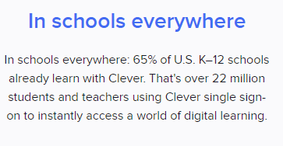
Introducing Clever!
Clever help center: https://support.clever.com/hc/s/?language=en_US
Clever Quick Start guide: https://clever.academy/quick-start-teachers

Slide 5
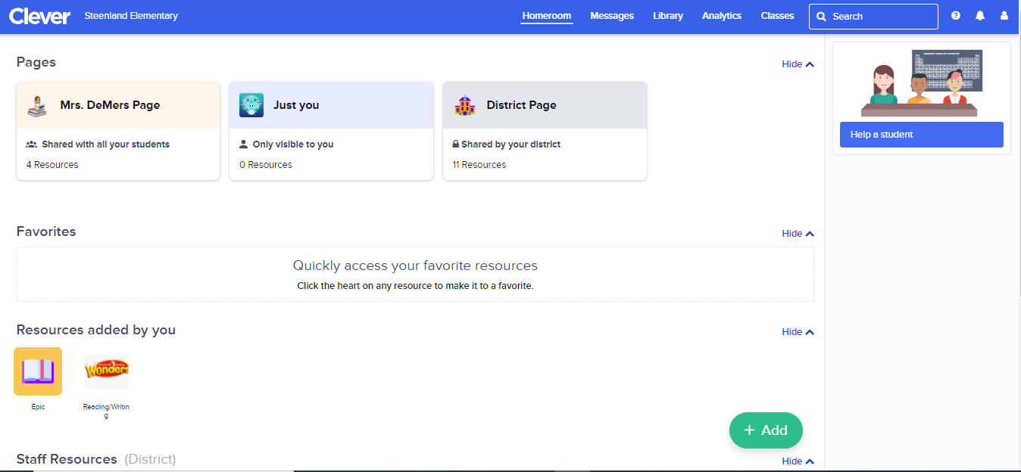
Teacher page -no need to remember login info! - message students and families -add apps and links -log entire class in or out of an app -Use analytics to track student activity -

Slide 6
What do the students see?

Slide 7
Schoology Elementary Experience

Slide 9
New in Schoology!!!
What is the Elementary experience exactly?
The Elementary experience offers a simplified version of the course that is focused on engaging students in a more visual and efficient manner. Once students navigate to the course, folders and materials are displayed as single cards on the page. Instead of the traditional course menu navigation on the left and Upcoming items on the right, students are presented with the most important content all at once. Course materials have also been simplified to a full-page view.
Teachers can customize the look of their course by adding featured images for each material type and folder to further enhance their course and help increase engagement and stimulation.

Slide 10
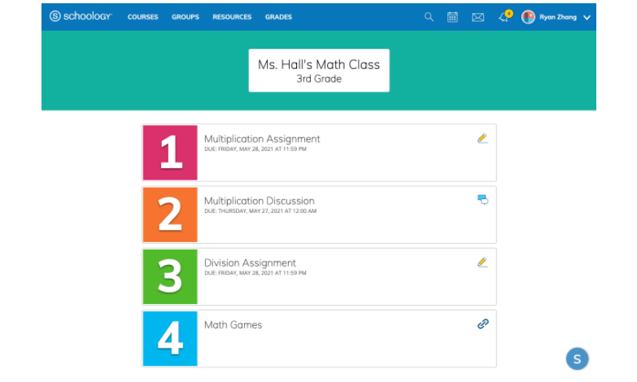
New in
Schoology!!!
Course view in the Elementary experience. Folders and materials are displayed as cards for a more simplified view. Each item has a Featured Image displayed to the left.

Slide 11
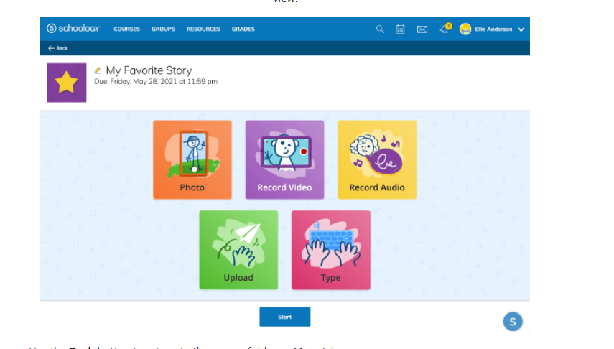
New in
Schoology!!!
Assignment view in the Elementary experience. Materials are displayed in a simplified full-page view.

Slide 12
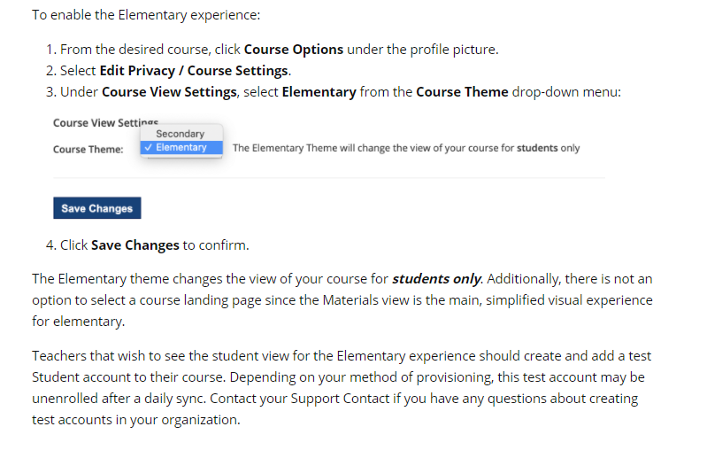
New in
Schoology!!!
For more information and a tour of the Elementary Experience check out this video at the 9:27 mark.

Slide 13
Blended Learning
*How can I use what I and the students learned about technology and blend it into my traditional classroom?
*How can I continue to use the technology that we have available in a face-to-face setting?

Slide 14
BLENDED Learning Tips

Slide 15
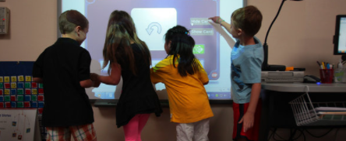
1. Schedule time to blend technology while teaching face to face.
Use laptops/i-pads to complete morning bell work. (journals, math)
Use centers and make one rotation i-ready time.
Use centers and use online resources for math or reading as a rotation
Have students research topics to write or review.
Use online tools as an Exit ticket.
Gamify the learning outcomes or standards

Slide 16
Share your ideas!
How did you use the new technology in your classroom last year?
How do you plan to use the technology this year?
Any great ideas?
Share them in the chat!

Slide 17
2. Utilize the online components of Reading Mastery, Everyday Math, and, TCI and Wonders.
Online activities and games
Editable online worksheets
Summative tests
Absent students can access work at home

Slide 18
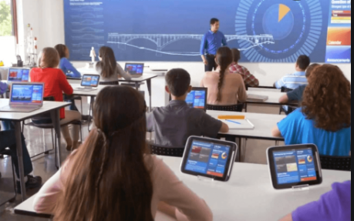
Why Interactives?
3. Use interactives to blend

Slide 19
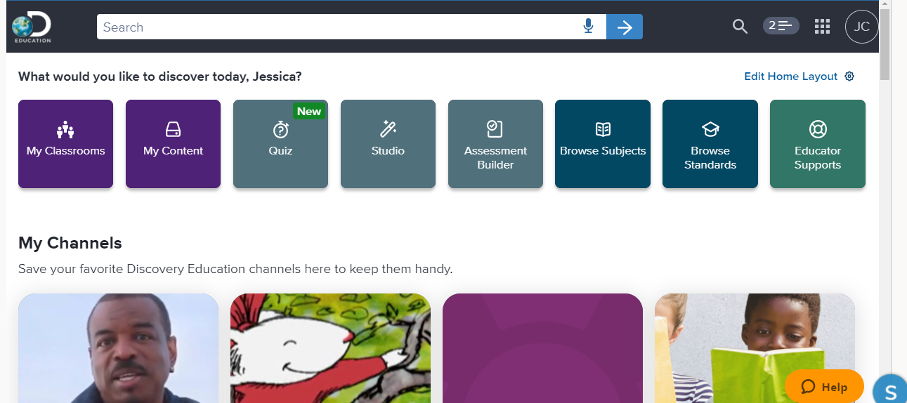
Discovery Education : A noteworthy interactive that we all have access to in the Waffle on Schoology!

Slide 20
Keep using your interactives or try out some new ones!
Here a few popular interactives to check out this year!
Quizizz
Kahoot
SeeSaw
Classflow
Discovery
Epic
Padlet
EdPuzzle
Spelling City
Cool Math
ABCya
Quizlet
StarFalll
Khan Academy

Slide 21
Want to learn more about interactives/interactive learning?
Check out 21 Things for Teachers: Thing 12, Interactive Learning
https://21things4educators.net/12_Interactive_Learning/define.html
More links to interactive learning resources/sites:
https://21things4educators.net/12_Interactive_Learning/additional_resources.html

Slide 22
Time to Explore!
Take a few minutes to explore a few interactives that you can use while blending your classroom this year!
Grades 3 and up: Make sure you check out the recording of the other presentation to learn about GoGuardian
Log into Clever:
1. Navigate to the following URL: clever.com/in/roseville
2. Click "Log in with Office 365".
3. Enter your district email address and password if you are not already logged into Office 365.
4. Click Sign In

Slide 23
Share your ideas!
What did you find that you might use?
What interactives might you use this year?
HOW will you implement them in your classroom?
Share them in the chat!

Slide 24
Keep on Blending and have a great school year!
This Photo by Unknown Author is licensed under CC BY-SA-NC

