Slide 1
Elementary Tools of Engagement:
Everyday Math
Refresher/Tips & Tricks

Slide 2
Background of Everyday Math:
Developed by the University of Chicago School Mathematics Project
Based on research about how children learn and develop mathematical power
Provides the broad mathematical background needed in the 21st century
Aligns with Common Core Standards

Slide 3
A spiraling curriculum:
Mastery of mathematics concepts and skills comes with repeated exposure and practice, not after just one lesson
Enables new connections and building on what has already been learned while learning more difficult and challenging content

Slide 4
Components of an Everyday Math Lesson
Warm-up activities: mental math; math message
Introduction of new content
Ongoing learning practice
Homelinks
Assessments
This program is created to develop mathematical literacy

Slide 5
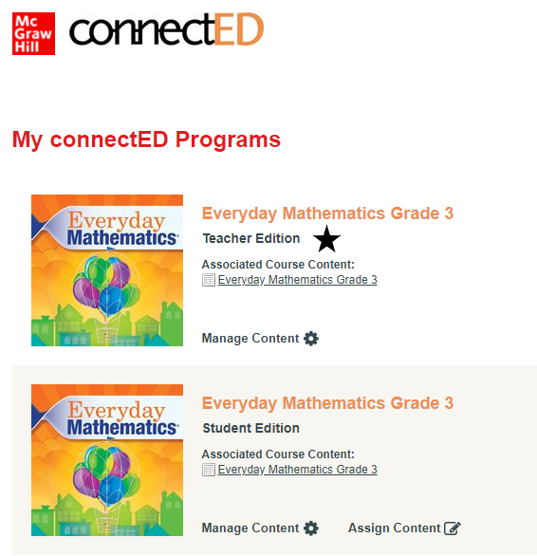
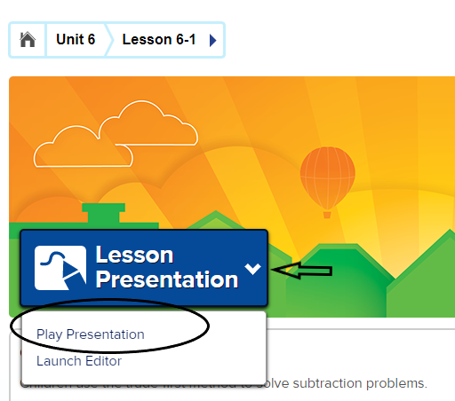
Presentation Tool
The "presentation tool" is a great way to engage your students (F2F and virtual) and take them through the math lesson.
It is in your online "teacher manual":
Make sure you are on the right lesson, click the "v", and "play presentation":

Slide 6
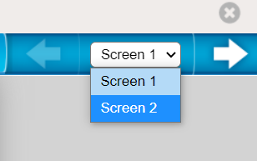
Moving through the presentation:
As you move through the presentation, be aware there are TWO sets of "arrows" that help you progress.
The set in the upper right-hand corner take you through the different slides that are assigned to a particular section of the lesson:
The set in the lower left-hand corner take you through the different sections of a lesson, for example: mental math and fluency, math message, summarize, math boxes, etc.:

Slide 7
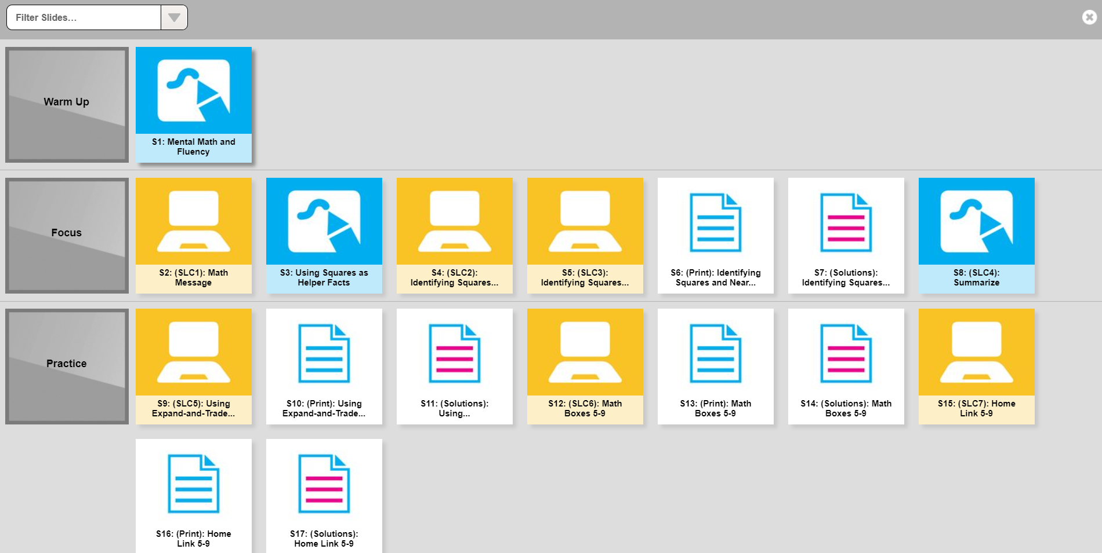
The "waffle" located at the bottom of the presentation tool:
The "waffle" represents all the slides for a particular lesson. If you would like to quickly go from mental math to math boxes, simply click the waffle and choose the slide you would like to project.
Quickly filter slides
that you don't want
projected to
your class,
for example,
slides that have
answers on them.

Slide 8
E-Books
New and improved e-Journal:
PDF directions for navigating a student math journal.
Video link to take your through the student's math journal:
Click here for video.

Slide 9
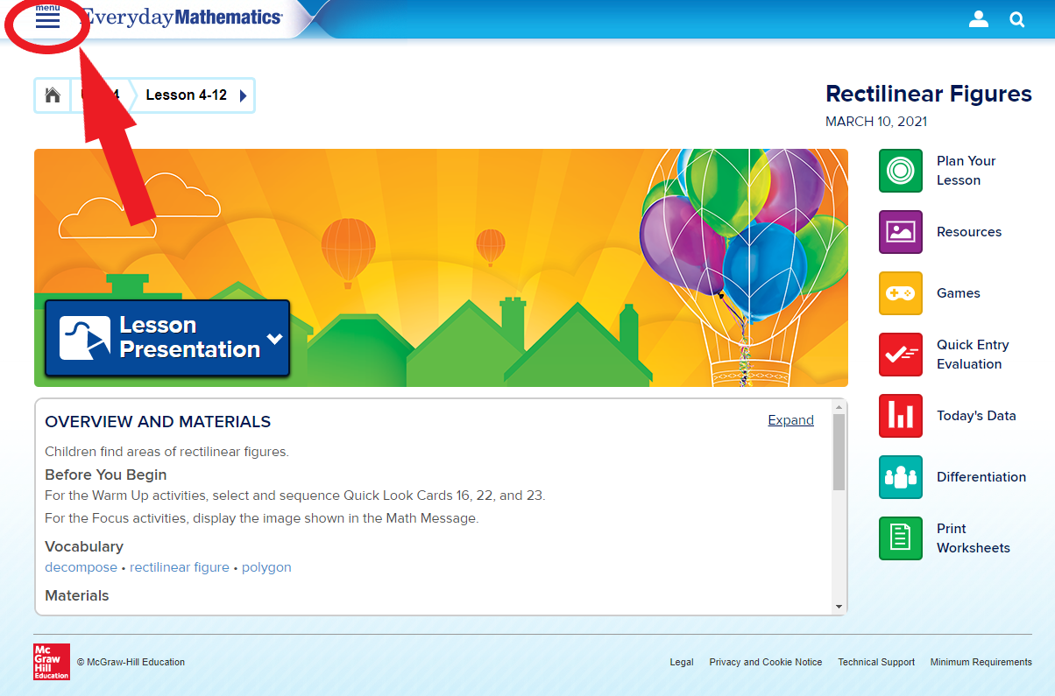
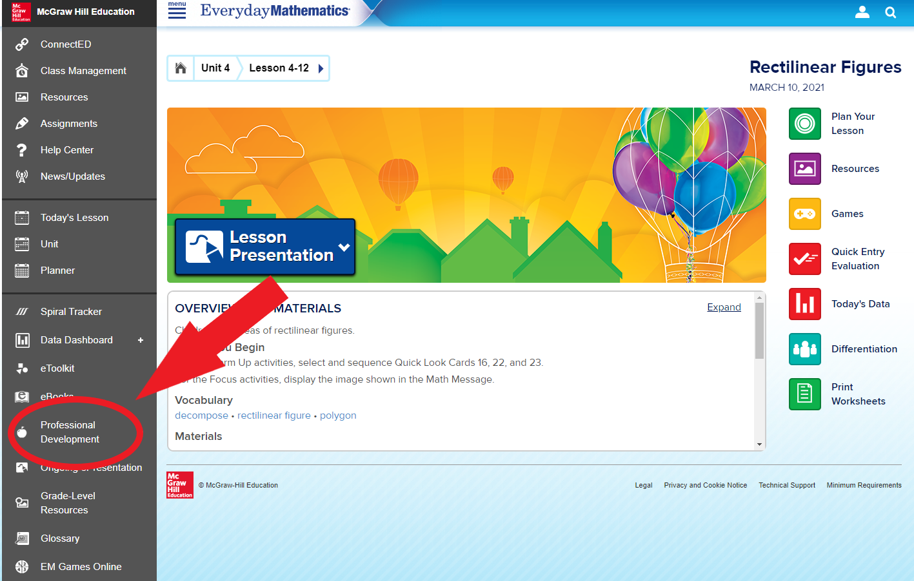
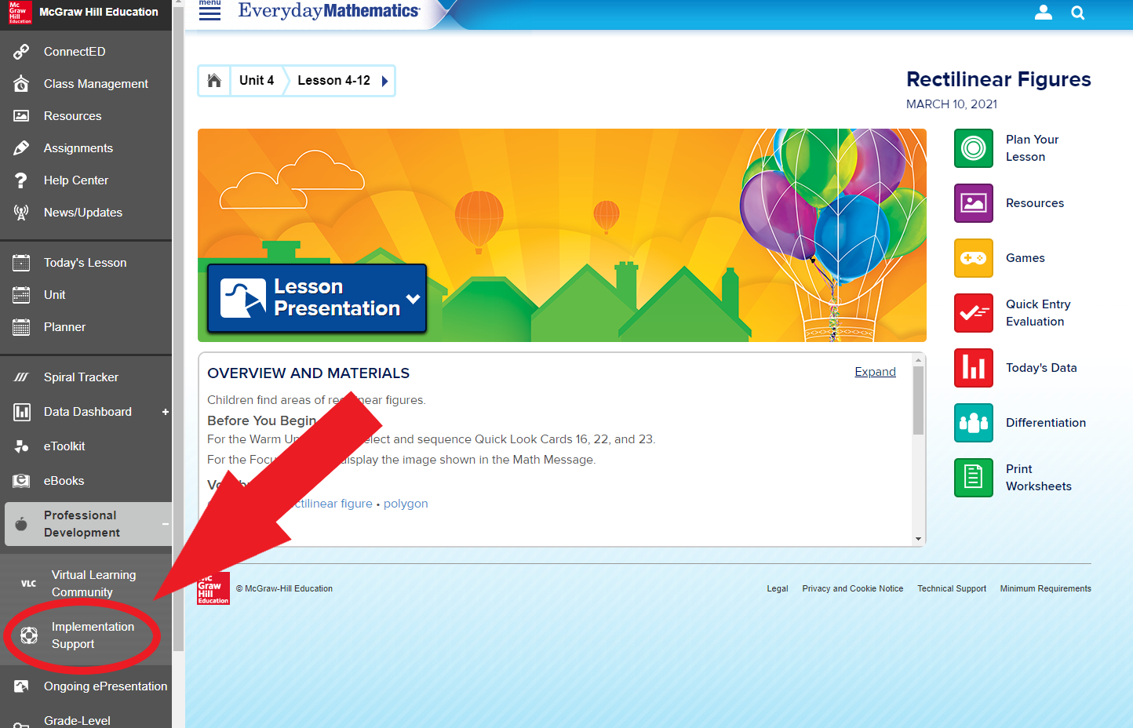
Digital Everyday Math Resources
Directions on how to get to resources
1. After logging into EM, click on Menu
2. Click Professional Development
3. Click Implementation Support

Slide 10
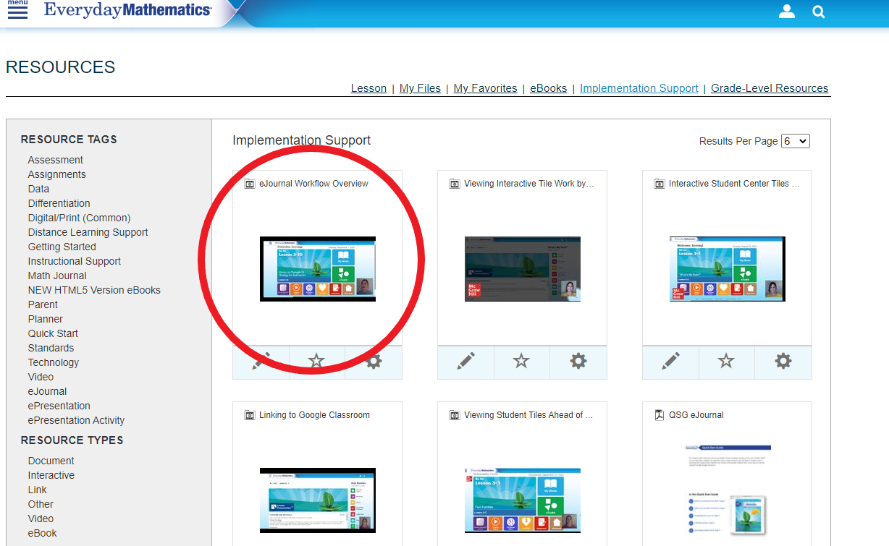
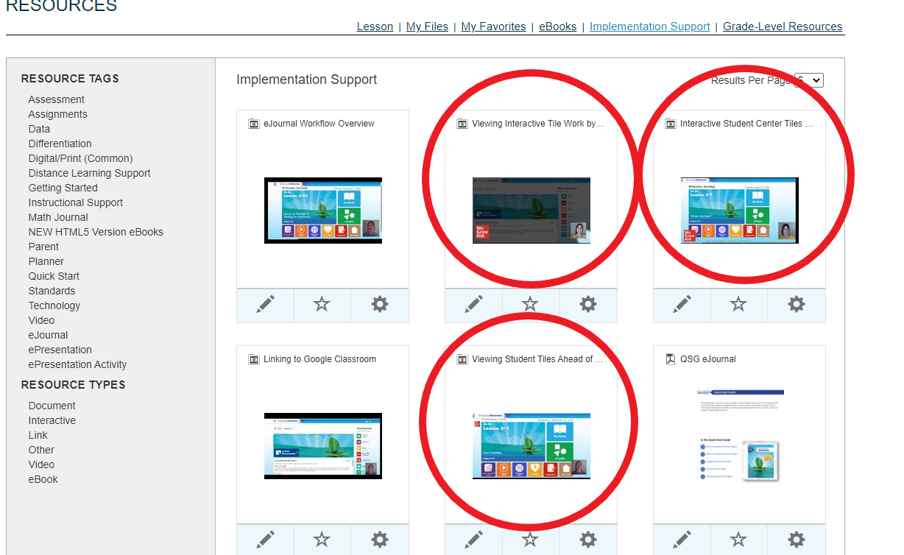
Digital Everyday Math Resources
Watch these videos on the EJournal and the EPresentation Tiles

Slide 11
Remote Learning Guides
Click Menu
Click Professional Development
Click Implementation Support
Click Distance Learning

Slide 12
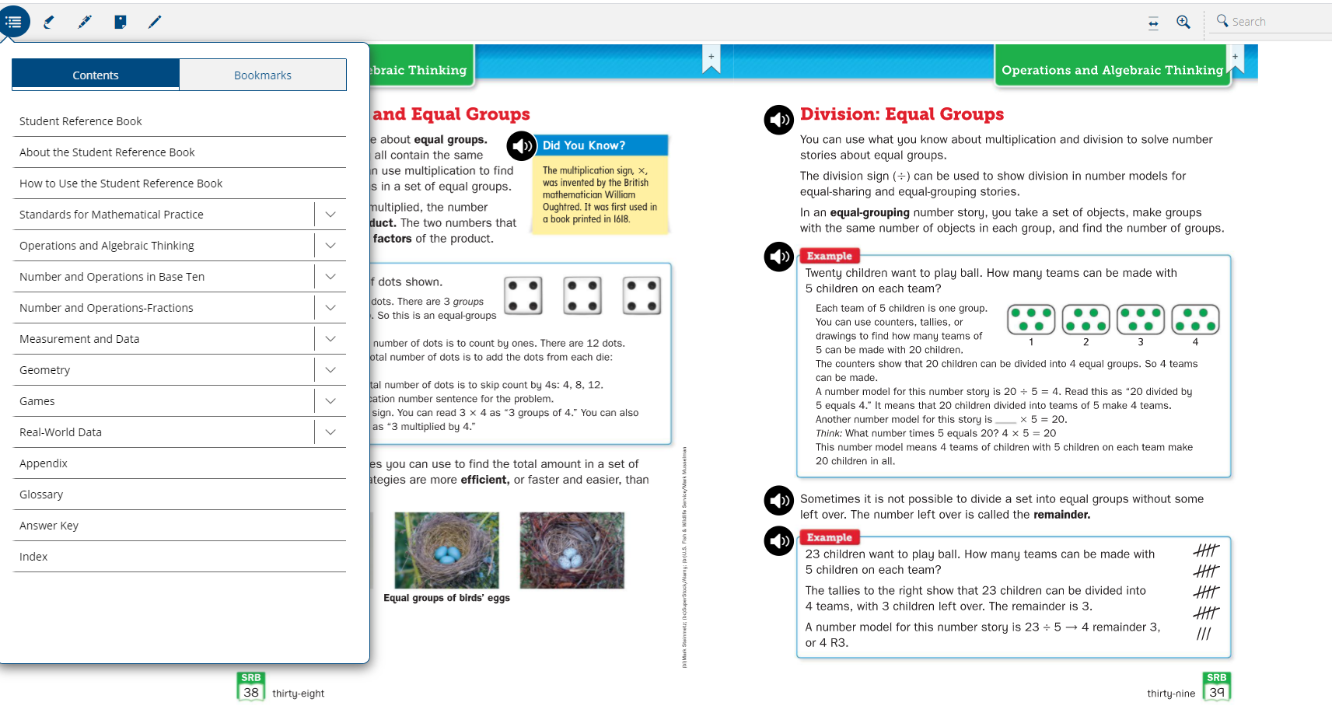
Digital Student Reference Book
Use the Digital Reference book to show examples

Slide 13
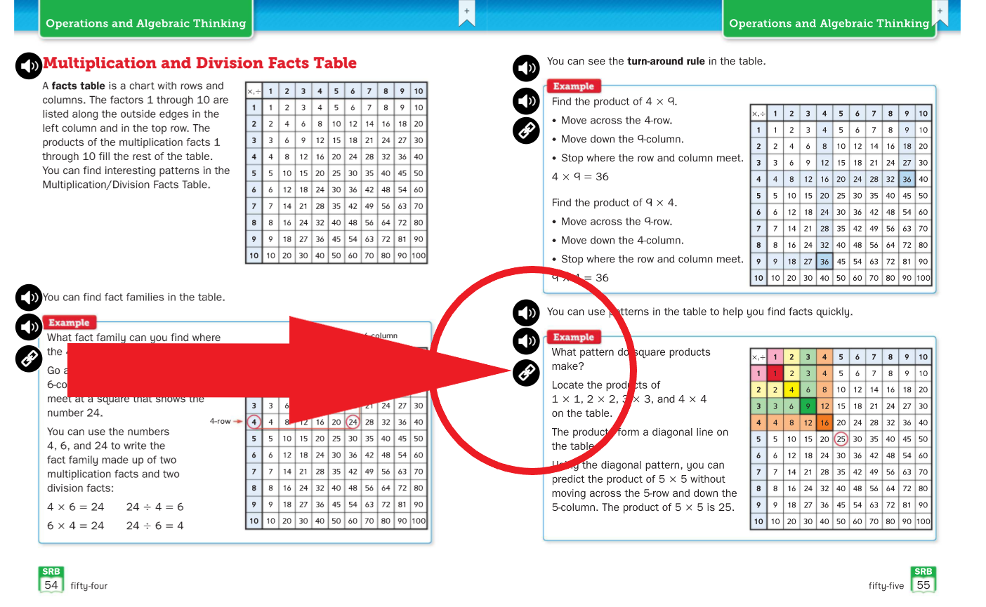
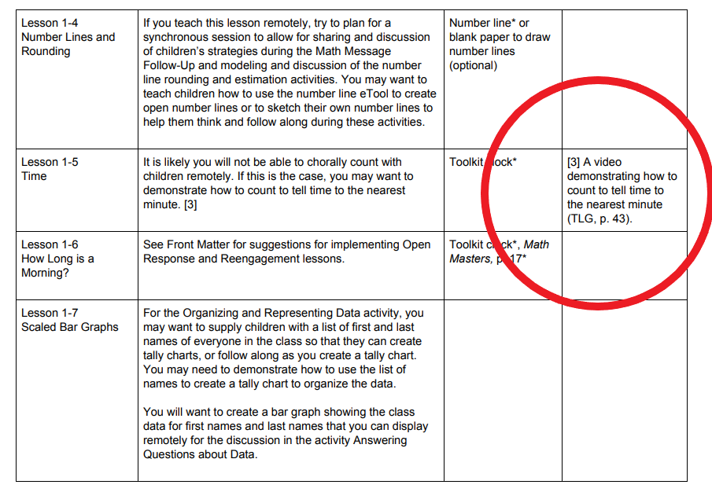
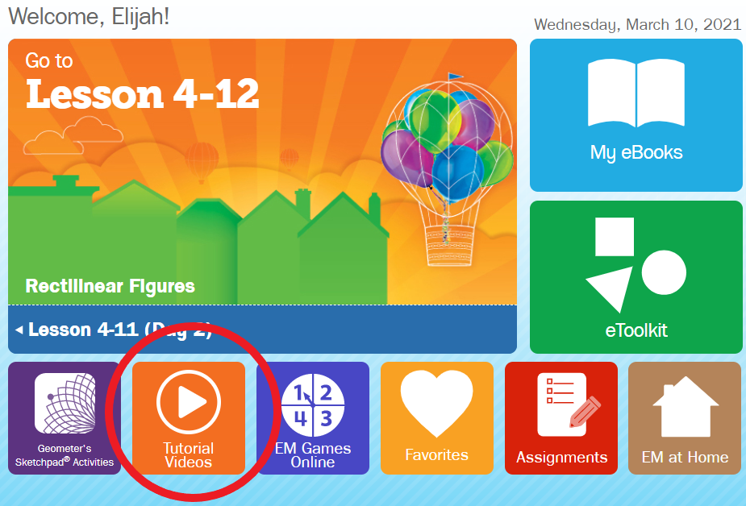
EM Tutorial Videos
You can find the tutorial videos in different places
Student Reference Book
Show these videos in class
Share with students and parents where to find the videos
Record and put a link in Schoology.
Remote Learning Guide
Student Digital Lesson

Slide 14
If you haven’t already, be sure to join the Virtual Learning Community. The Everyday Mathematics Virtual Learning Community (VLC) provides a space for teachers to view and share resources that support mathematics teaching, communicate with other teachers about pedagogy, and take time to reflect on their practice. You will also find PD, curriculum guides, freebies, and much more!
Click here to join! Scroll to the bottom and follow the prompts.

Slide 15
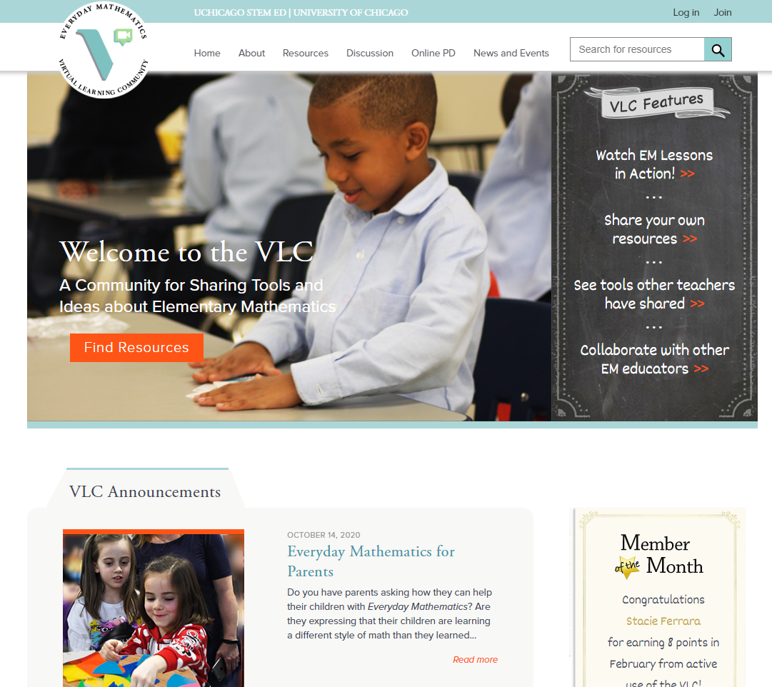
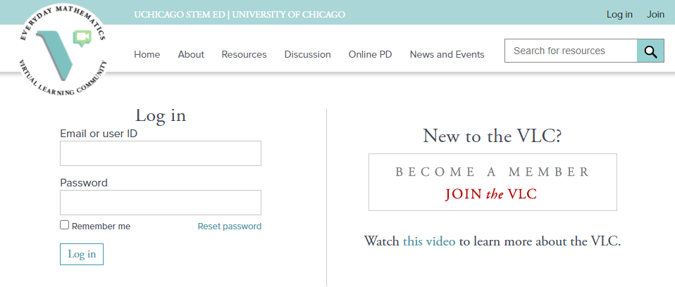
Virtual Learning Community in EM

Slide 16
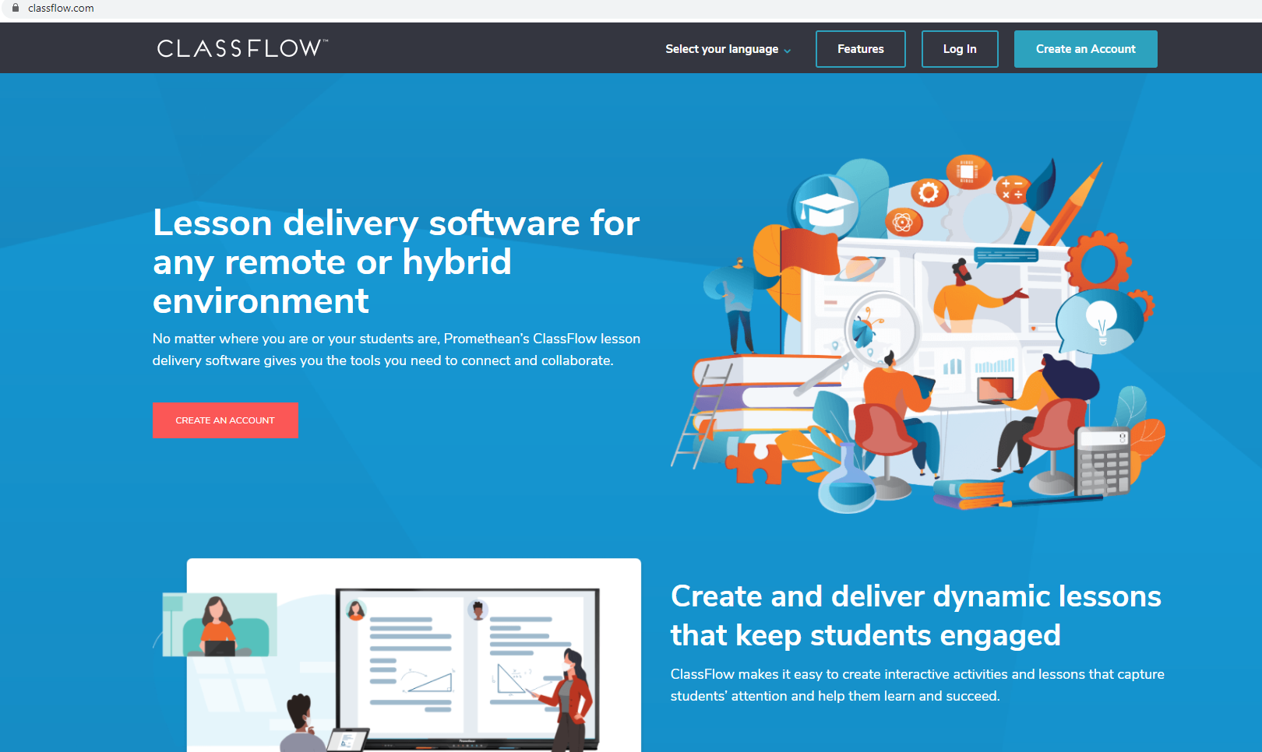
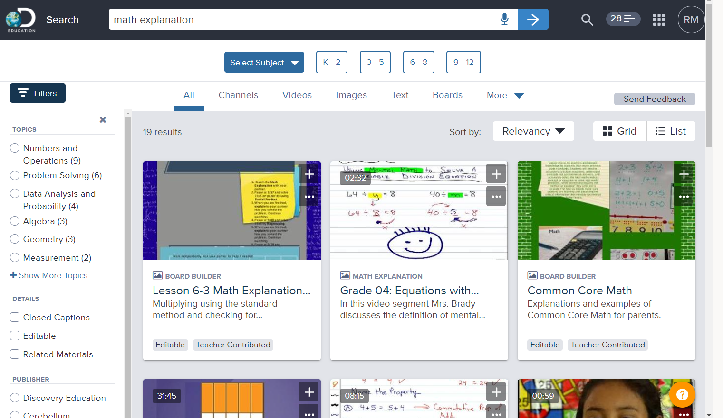
Other digital ideas to support EM
Whiteboard.fi
Classflow
DiscoveryEducation

Slide 17
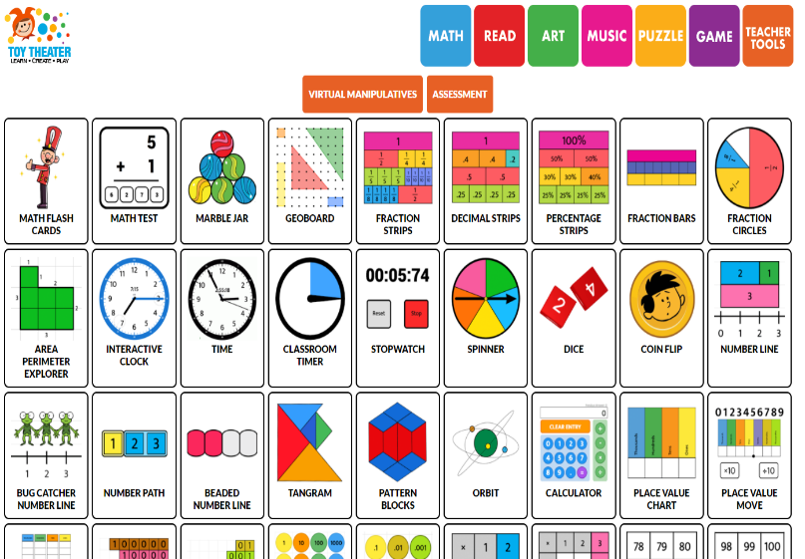
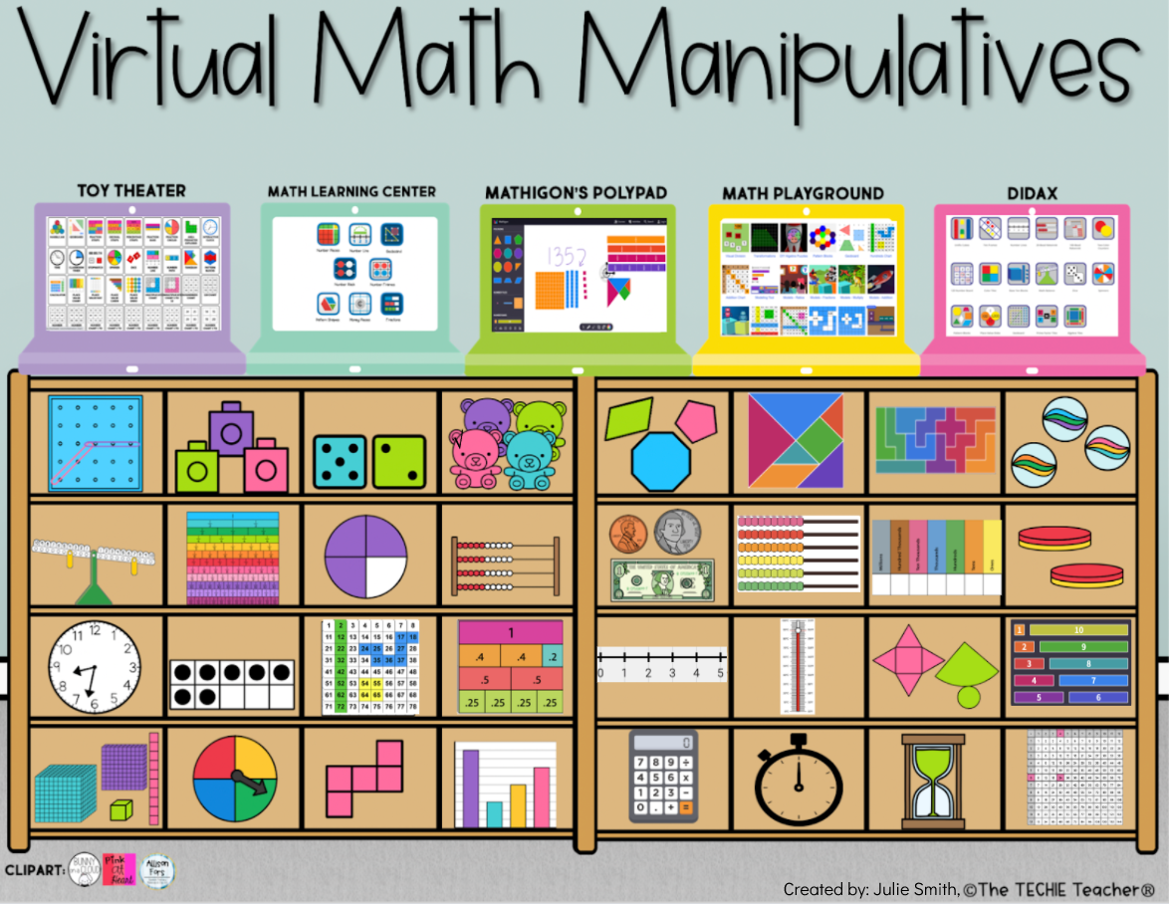
Virtual Math Manipulatives
Toy Theater (Click Here):
Virtual manipulatives and so
much more.
Check out the “Teacher Tools”.
Virtual Math Manipulatives (Click Here):
Virtual manipulatives and so
much more.
Check out the “Teacher Tools”.

